Slide 1
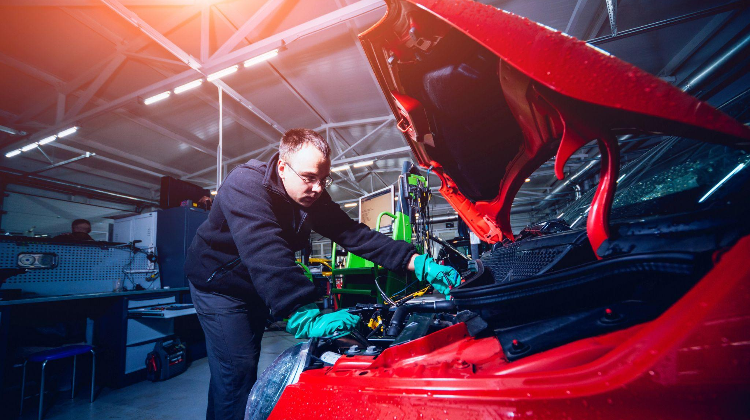
Massachusetts Climate Careers: Powering the Future
Transforming Transportation
Lesson 1. Understanding and Combating Climate Change
|
1
Notes:
Today, we’ll explore how transforming transportation with electric vehicles can reduce emissions, improve air quality, and change how we think about travel and mobility.

Slide 2
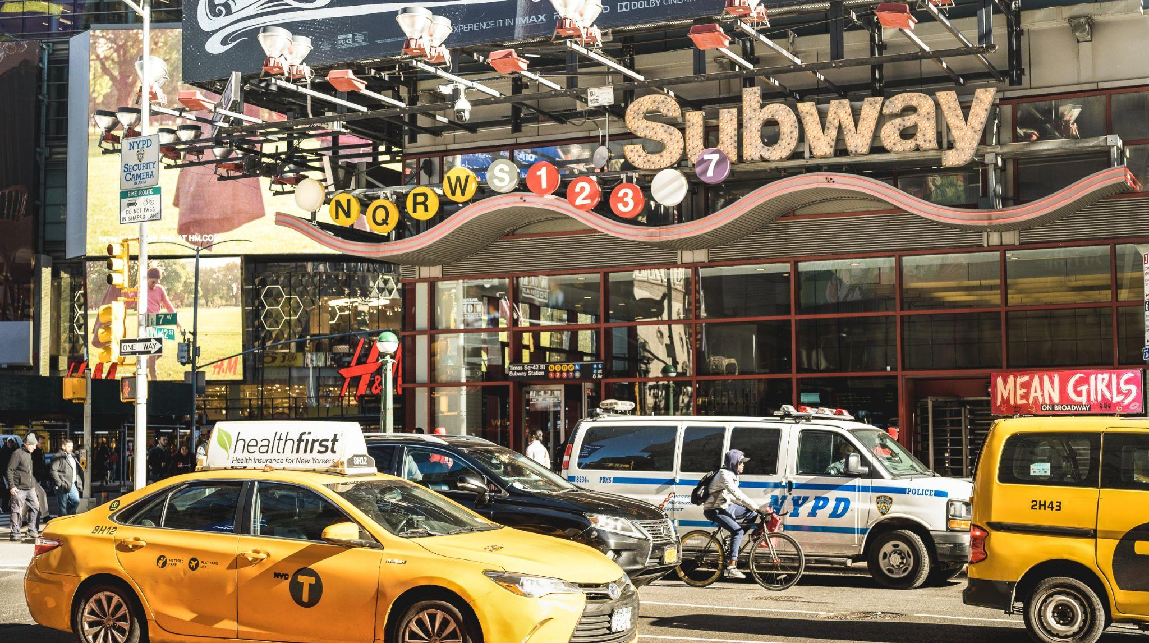
Opening Activity
What would need to change in order to make all cars and public transit electric?
Lesson 1. Understanding and Combating Climate Change
Notes:
Activity objective: Students think about the bigger picture of what influences wide-scale change in society.
Instructions
Students can do this activity in small groups, in pairs, or as a class.
Ask students to consider all modes of vehicles and public transit, and then brainstorm and discuss what would need to change to make all cars and public transit electric.
Students should consider both technological and social infrastructure-related barriers to transformation and adoption of new technologies.
After a couple of minutes, if students have been discussing in pairs or small groups, ask a few of them to share their suggestions with the class and highlight common themes.

Slide 3
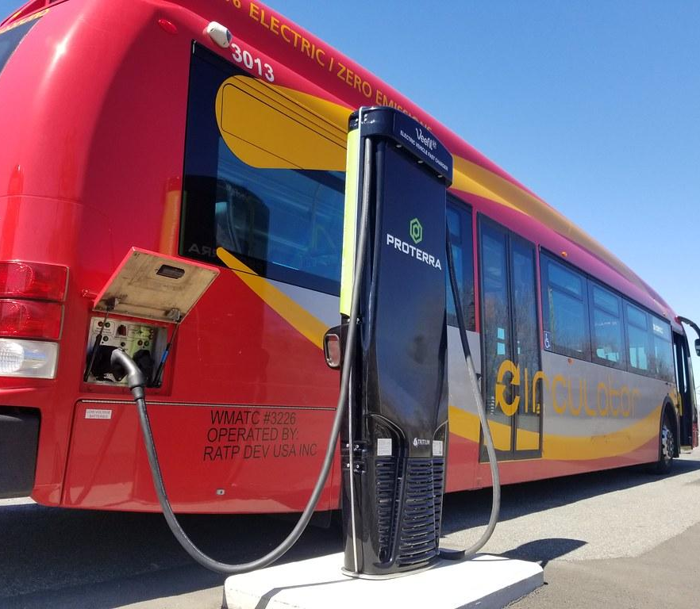
Electric DC circulator bus at charging station.
Today’s Agenda
The Big Question and My Climate Goals
Climate Watch and Discussion
Clean Electric Transportation
Design a Downtown Charging Network
Takeaways and Closing
Lesson 8: Transforming Transportation
Notes:
Here’s what we’ll be covering today: electric transportation and its impact on the environment and Massachusetts’s climate goals.

Slide 4
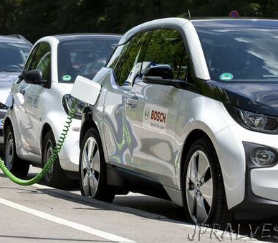
How can electric vehicles support our transition away from fossil fuels?
The Big Question
Lesson 8: Transforming Transportation

Slide 5
When you complete this lesson, you’ll be able to:
Describe the benefits of electrifying transportation and explore solutions to some of the most significant barriers.
Identify climate-critical professionals who work on electric vehicles and charging infrastructure.
Discuss what communities need to electrify transportation fully.
My Climate Goals
Lesson 8: Transforming Transportation
Notes:
Today, we’ll be exploring the role of electric vehicles and the professionals who make this transformation possible.
Please note, we are not only talking about electric cars; this includes electric transportation of all kinds as well as the infrastructure that makes electrifying transportation possible.

Slide 6
Transportation Heroes
Roles in electric transportation projects:
EV technicians: Maintain and repair electric vehicles
EV charging equipment technicians: Install and service charging stations
Engineers (automotive and chemical): Design vehicle systems and improve battery technology
Car salespeople: Educate customers on EV benefits and maintenance needs
Lesson 8: Transforming Transportation
Notes:
These professionals are critical in making electric transportation accessible and practical.
Each role brings unique skills to support this transformation.

Slide 7
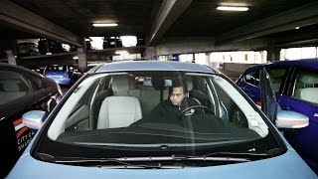
Climate Watch: Video
Lesson 8: Transforming Transportation
Notes:
Note to teacher: This video is a placeholder; the video created for this course will be available in spring 2025. You may skip this slide and the next if you wish.
Day at work: Electric vehicle technician (3-minute video from ConnectEd).
Per Joseph Hendry, ConnectEd, "Okay for you to do so with proper attribution for non-commercial purposes!")
https://youtu.be/M05oLsNnngY?si=w0LS2ypadA09qqbb
jhendry@connectednational.org
Project Associate, Administrator–IT Management and Operations
(510)343-9833
ConnectED: The National Center for College and Career make potential exponential

Slide 8
In the video, Ben works on electric cars and bikes. How do electric bikes help urban centers transition away from fossil fuels?
Ben describes engineering and design as working together. How do these two types of work come together in clean energy?
What stood out to you most about this video and the idea of working in electric transportation?
Climate Watch Discussion
Lesson 8: Transforming Transportation

Slide 9
MA Plan to Lower Transportation-Related Carbon Emissions
Strategy 1
Improve alternatives to personal vehicles for transportation
Strategy 2
Transition most vehicles on the road to electric vehicles
Lesson 8: Transforming Transportation
Notes:
Massachusetts has two primary strategies for lowering carbon emissions related to transportation:
1. Improving alternatives to personal vehicles
2. Transitioning most vehicles on the road to electric vehicles

Slide 10
Transit-Oriented Development
Designing and building communities so that housing, shops, and offices are located near accessible public transit options
Lesson 8: Transforming Transportation
Notes:
Transit-oriented development is one of the major strategies Massachusetts will deploy for improving sustainable transportation.

Slide 11
Transit-Oriented Development
Reduces the need for cars by making public transit more accessible
Lowers emissions by decreasing vehicle miles traveled
Increases walkability and bikeability of communities
Encourages a sustainable and livable community structure
Lesson 8: Transforming Transportation
Notes:
Transit-oriented development lowers emissions by decreasing the need for cars, contributing to a cleaner environment.
People use fewer cars because they have easy access to public transit or are closer to offices, shops, and other necessary community centers, making these communities more bikeable and walkable than others.
Beyond its environmental impact, this type of development can also foster community connections in other ways.

Slide 12
Electric Vehicles in Public Transit
MA plans to transition public transit vehicles to electric options to reduce emissions and improve air quality:
Electric buses for densely populated urban areas
Electric rail for high-traffic areas and long-distance travel
Electric school buses for transportation in school zones
Lesson 8: Transforming Transportation
Notes:
The second major strategy Massachusetts has for transforming transportation across the state is electrifying public transit. This includes buses, rail, and even school buses in some areas.
Electric public transit options help reduce the state’s overall carbon footprint.
By lowering emissions and improving air quality, these changes significantly enhance community health, which benefits everyone, especially in urban areas and around schools.
Switching to electric public transit encourages residents to rely less on personal vehicles, contributing to reduced total vehicle miles traveled.

Slide 13
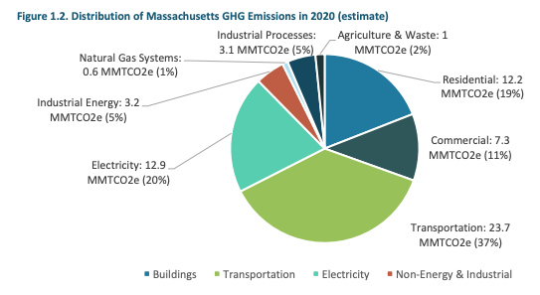
Why Electrify Transportation?
Courtesy XXXXXX
Lesson 8: Transforming Transportation
Notes:
Electrifying transportation is essential for reducing emissions and improving public health because transportation is currently the state's largest source of carbon emissions.
So, despite the challenges, it’s worth the effort.

Slide 14
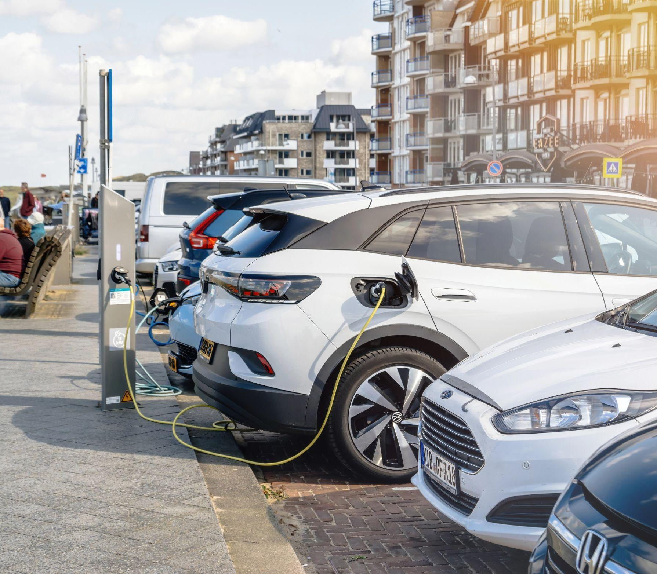
Benefits of EVs
Reduce air pollution
Reduce noise pollution
Use renewable energy sources
Able to store and provide energy when needed
Courtesy XXXXXX
Lesson 8: Transforming Transportation
Notes:
Electric vehicles can reduce pollution and improve overall quality of life, especially in high-traffic areas.
Benefits include reduced air pollution, since electric vehicles don’t produce any tailpipe emissions.
EVs are also much quieter than gas-powered cars, which lowers noise pollution, especially in urban or densely populated areas.
Unlike traditional cars, they can be powered by renewable sources like wind, solar, or geothermal systems.
Because they connect to the power grid, electric cars can store energy and feed it back to your home or even the grid for later use. This is becoming more common now and is a real benefit because it allows you to use your electric vehicle as a backup generator in the case of a power outage.
Imagine if cities could use electric buses or trains in this same way to feed power back to essential services like hospitals or fire stations.

Slide 15
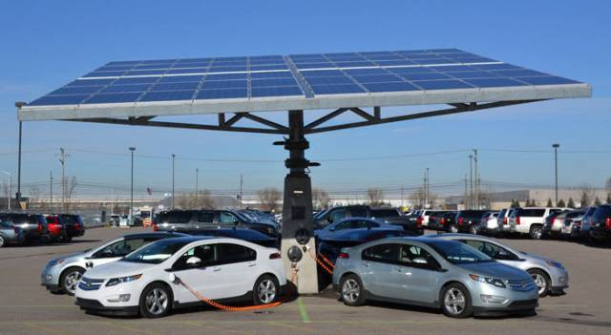
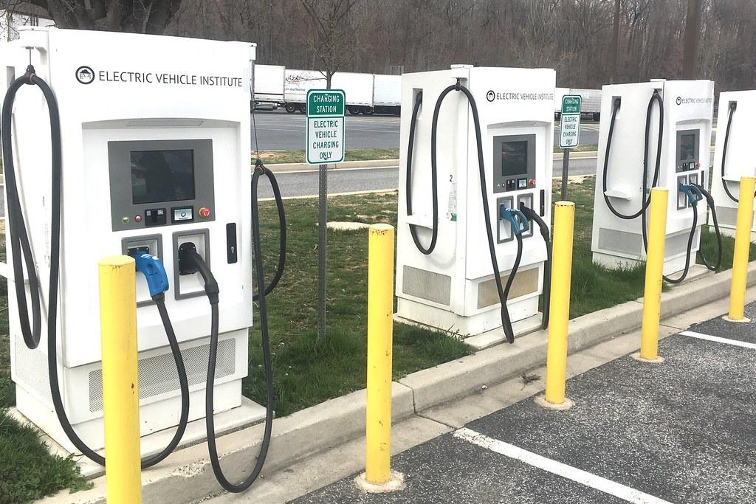
Challenges and Barriers
EVs and charging infrastructure are expensive.
Charging EVs on long trips is inconvenient.
Resistance to transit-focused development projects
Limited charging stations, especially in rural or crowded areas
Lesson 8: Transforming Transportation
Notes:
People will raise many challenges and barriers to adopting electric transportation, and these are four of the most common.
Public resistance to changes such as transit-oriented development: This could mean plans to build more housing near public transit to reduce the need for cars or new infrastructure that supports electric transportation.
High costs of electric vehicles and charging infrastructure: There may be a high upfront cost, and for many people, knowing that it’s cheaper in the long run is insufficient.
Limited charging infrastructure, especially in rural and multifamily areas: If everyone starts using electric cars, do we have the capacity to accommodate their charging needs? Do we have charging stations? Does our grid have the capacity to charge that many vehicles? What about adding public transit vehicles?
Concerns about the convenience of finding chargers on long trips: While some stations charge EVs faster than others, a few surpass the speed of refilling a gas tank. People driving for long hours may not want to pause for their car to recharge halfway. This is relevant for individuals like long-haul truckers or for vehicles like buses that are expected to run continuously for specific durations; the need for additional charging time must be factored into schedules and routes.

Slide 16
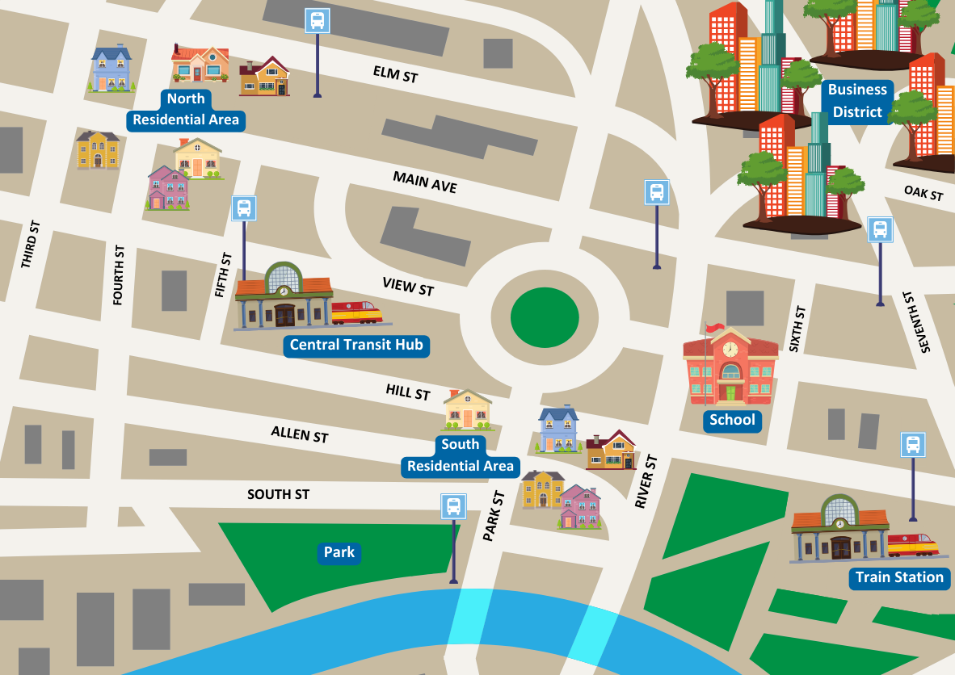
Group Activity
The city planner wants a proposal for where to place EV chargers downtown.
In groups, design your network and prepare to present it to the city council for a vote.
Lesson 8: Transforming Transportation
Notes:
Activity objective: Students must consider the factors that go into a desirable location for an EV charging hub. Groups will work to design EV charging networks to maximize accessibility and efficiency.
Instructions:
Divide students into groups and direct them to their worksheets, which contain the maps, criteria, and budget information for the activity. Since all groups will be working from the same prompts, the teacher can choose the size of the groups.
After examining the provided information, each group will design an EV charging network for a fictional town that maximizes accessibility and efficiency. Students must consider public concerns, budget constraints, existing infrastructure, and accessibility.
Criteria:
Accessibility: Proximity to bus/train lines and major roads
Public concerns: Address potential pushback on development or disruption
Efficiency: Think about traffic flow and high-demand areas
Networks can consist of a combination of three types of charging stations:
Small (car only): Low cost, minimal disruption, suitable for residential areas
Medium (car and bus): Higher cost, longer installation time, best near transit hubs
Multiuse (car and bike): Moderate cost, appealing to urban users, good for business districts
Students will design their system by following the prompts on their worksheets and present their plan to the “city council” (the rest of the class). Their presentations should include the following:
How they will allocate funds to maximize the impact across the city
Why they believe their location choices to be the most beneficial
How they plan to handle potential concerns from residents or businesses
Please encourage students to share why their plan will encourage people to transition to using EVs while minimizing public resistance

Slide 17
Activity Debrief
Where will you place your stations? Provide your reasons.
How will you manage any concerns from the public?
Lesson 8: Transforming Transportation
Notes:
Debrief discussion:
After each group presents, facilitate short discussion to compare plans.
Ask students to vote (as “city council”) on which plan they want to implement for their town.
Ask students about the most important factors they considered when planning their designs. What factors were most important in evaluating the designs?
Designing an effective EV charging network involves careful consideration of community needs, financial constraints, and logistical challenges.
Bringing EV infrastructure into any community is challenging, even if the community is supportive.

Slide 18
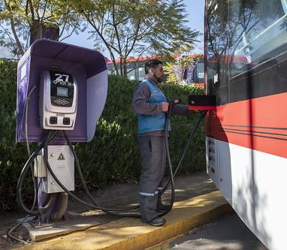
Key Points
Electric transportation helps reduce emissions, improve air quality, and support grid resilience.
Barriers include cost, infrastructure limitations, and public resistance to change.
Careers in EV technology are critical to achieving sustainable transportation.
Lesson 8: Transforming Transportation
Notes:
Review each point and reinforce the importance of a collective effort to overcome common barriers.

Slide 19
Before You Go
If you could add one feature to EV vehicles to speed up public transition, what would it be and why?
What do you think is the greatest challenge of transit-oriented development (TOD) projects?
Closing Activity
Lesson 8: Transforming Transportation
Notes:
Please encourage students to respond to one or both questions aloud or in their journals or worksheets.
Follow-up: How might this challenge to Transit-Oriented Development be addressed?

Slide 20
Lesson 1. Understanding and Combating Climate Change
|
20

